Slide 1
Project Title :
A Personalized Nutrient-Based Meal Recommender System

Slide 2
Abstract
On the Internet, where the number of choices is overwhelming, there is need to filter, prioritize and efficiently deliver relevant information in order to alleviate the problem of information overload, which has created a potential problem to many Internet users. Recommender systems solve this problem by searching through large volume of dynamically generated information to provide users with personalized content and services.

Slide 3
Introduction
This project is an approach for recommending healthy and nutritional diet by Data mining algorithms, it envisaged personalized meal on the basis of Nutrient user prefer, disease/medical condition he has or has been through and particular diet he/she wants to maintain, recommender system focuses on every individual based on their eating habits and body statistics, system uses an adapted collaborative filtering approach to recommend food based on healthiness and taste ratings of other users.

Slide 4
Objective
The goal of application is to provide a platform where users find their Nutritious food according to their personal health preferences and build a behavior of living healthy life.

Slide 5
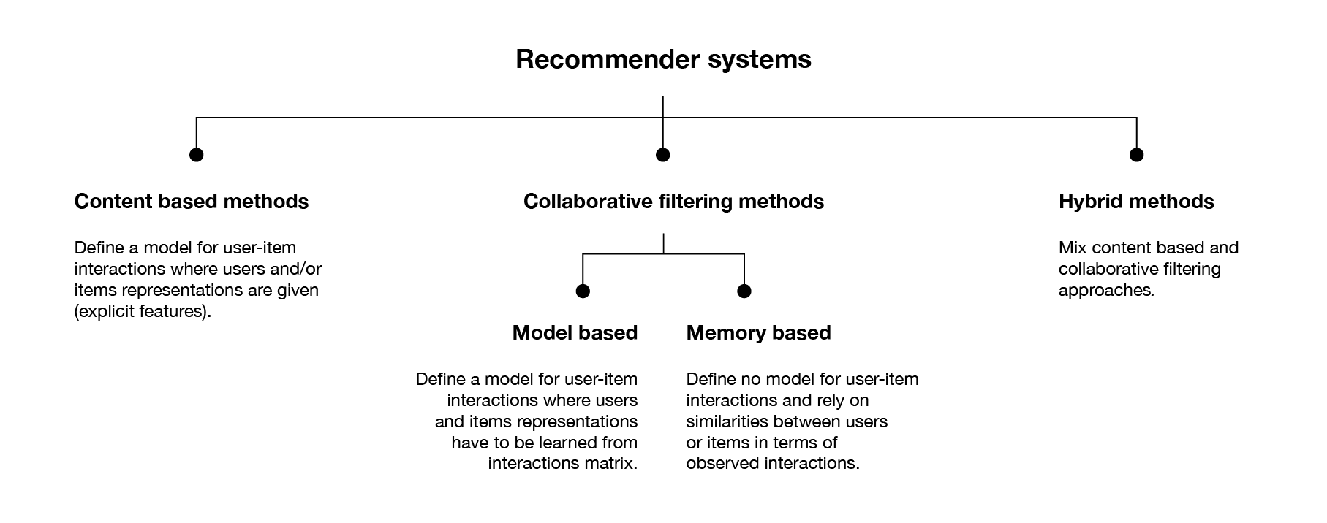
Existing Systems

Slide 6
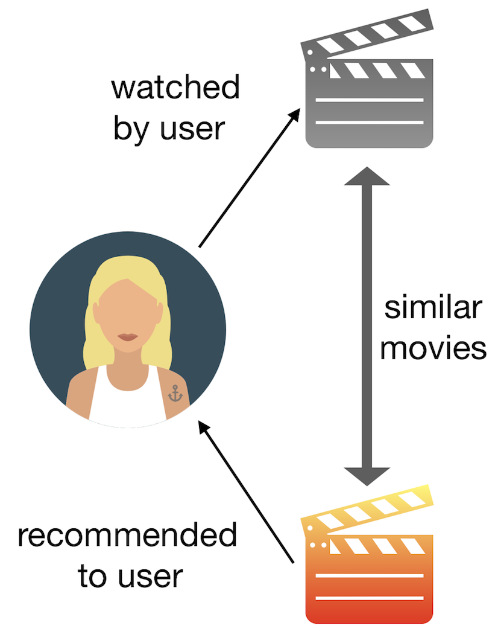
Requirement Analysis
For Example A Movie
1.Content based Filtering
Content Based Filtering Algorithm: In a content-based recommender system, keywords or attributes are used to describe items. A user profile is built with these attributes. Items are ranked by how closely they match the user attribute profile, and the best matches are recommended. Content-based filtering recommends items based on a comparison between the content of the items and a user profile.

Slide 7
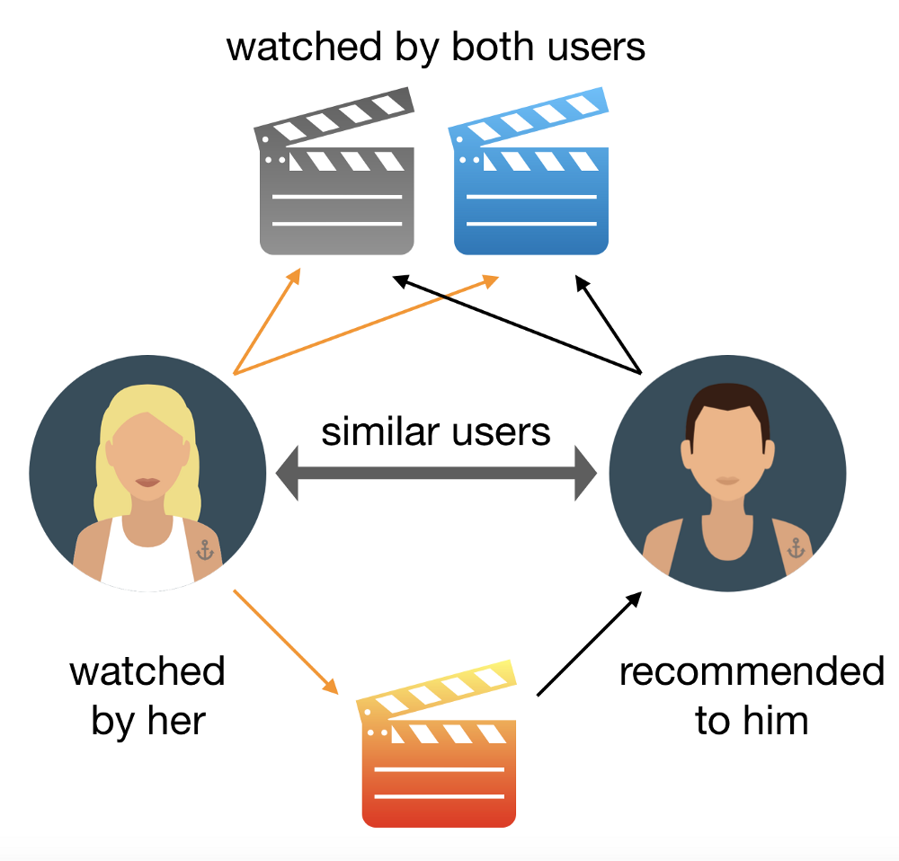
Requirement Analysis
For example a Movie
2.Collaborative Filtering
This type of filter is based on users’ rates, and it will recommend us movies that we haven’t watched yet, but users similar to us have, and like. To determine whether two users are similar or not, this filter considers the movies both of them watched and how they rated them. By looking at the items in common, this type of algorithm will basically predict the rate of a movie for a user who hasn’t watched it yet, based on the similar users’ rates.

Slide 8
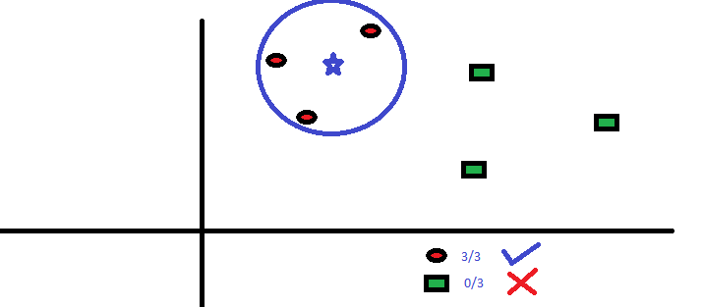
Algorithm And Methodology
K nearest Neighbour
We’ve used K-nearest neighbor , a very simple machine learning algorithm. K-nearest neighbor finds the k most similar items to a particular instance based on a given distance metric like Euclidean, jacquard similarity , minkowsky or custom distance measures.
KNN is used for both classification and regression problems. In classification problems to predict the label of a instance we first find k closest instances to the given one based on the distance metric and based on the majority voting scheme or weighted majority voting(neighbors which are closer are weighted higher) we predict the labels.

Slide 9
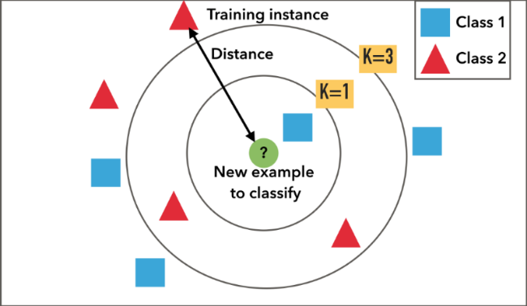
KNN does not make any assumptions on the underlying data distribution but it relies on item feature similarity. When KNN makes inference about a item, KNN will calculate the “distance” between the target item and every other item in its database, then it ranks its distances and returns the top K nearest neighbor movies as the most similar movie recommendations.

Slide 10
The Algorithm
1.Load the data
2.Initialize K to your chosen number of neighbors
3. For each example in the data
4. Calculate the distance between the query example and the current example from the data.
5. Add the distance and the index of the example to an ordered collection
6. Sort the ordered collection of distances and indices from smallest to largest (in ascending order) by the distances
6. Pick the first K entries from the sorted collection
7. Get the labels of the selected K entries
8. If regression, return the mean of the K labels
9. If classification, return the mode of the K labels

Slide 11
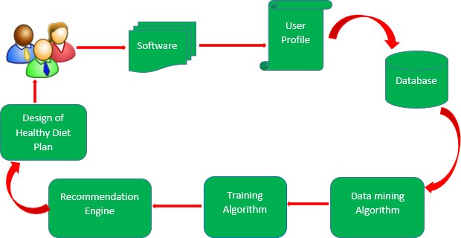
Block Diagram
Collect data
Initial Recommendation – Content based
Meal Recommendations
Item-Item
(collaborative)
Similar users
User-User (collaborative)
Data Mining algorithms

Slide 12
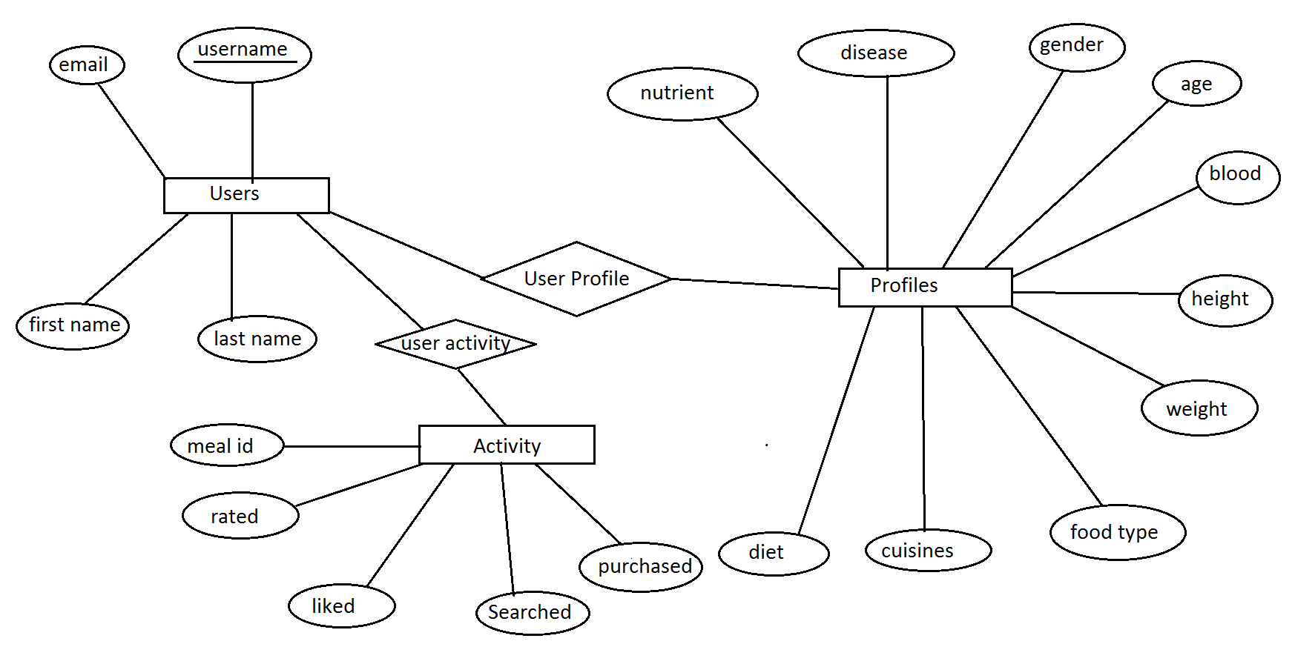
Entity–relationship model

Slide 13
Technology used
Python and it’s libraries
Pandas
Numpy
Matplotlib
Seaborn
Sklearn
Django framework

Slide 14
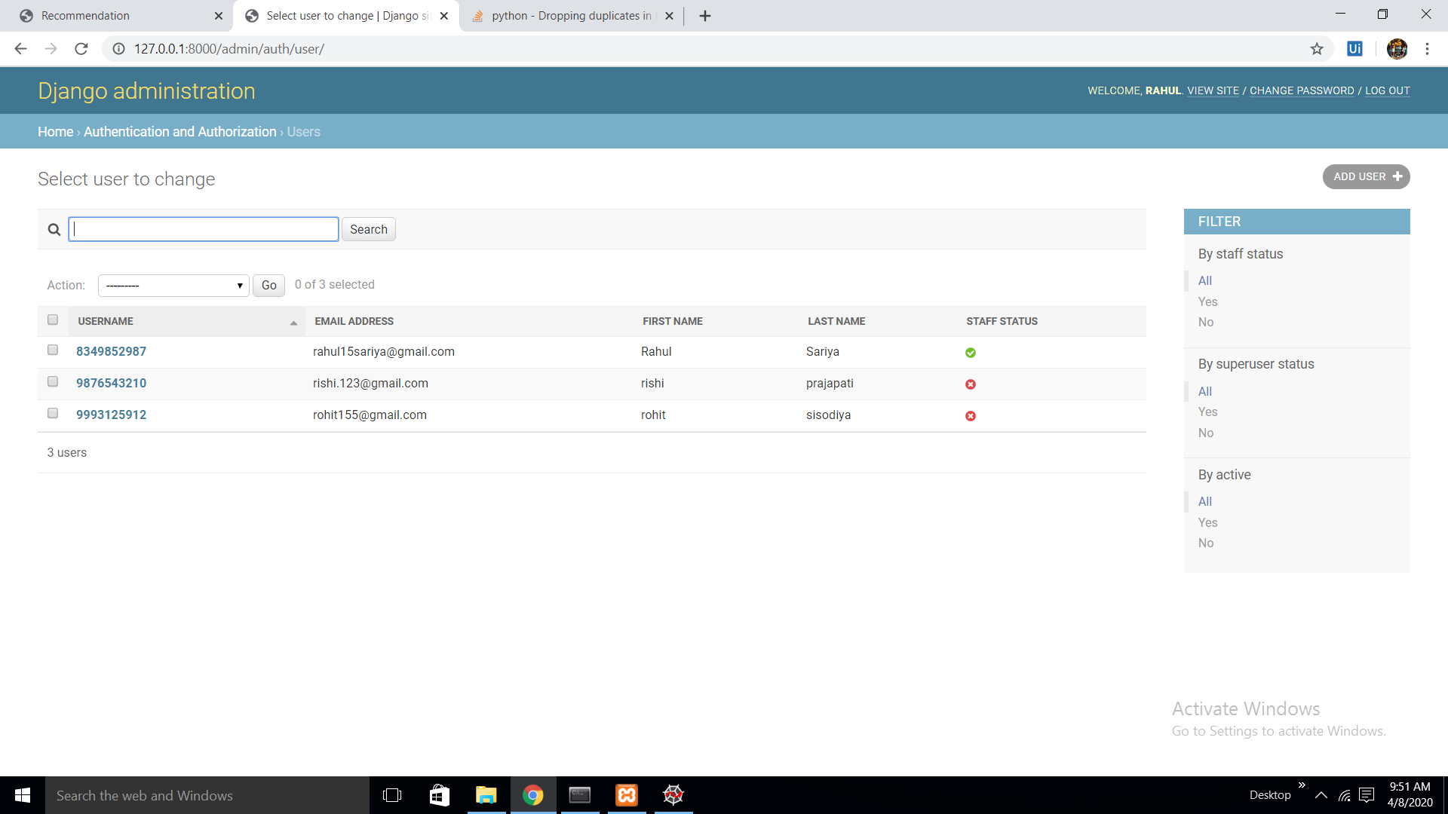
Database

Slide 15
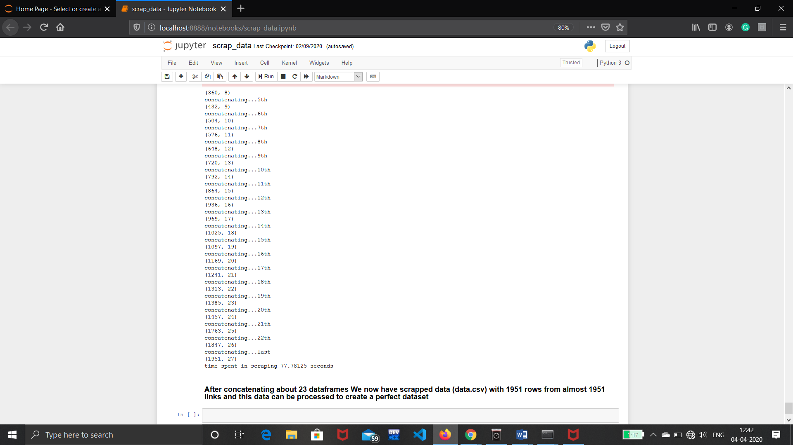
Implementation
1. Data Collection (Web Scraping)
The Data was collected by scraping various sites

Slide 16
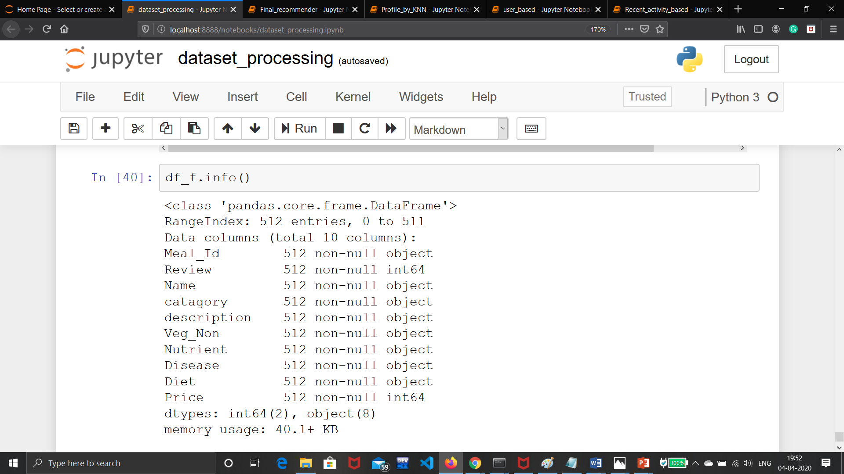
2. Dataset Processing
Adding Attributes
Noise Removal
Missing values

Slide 17
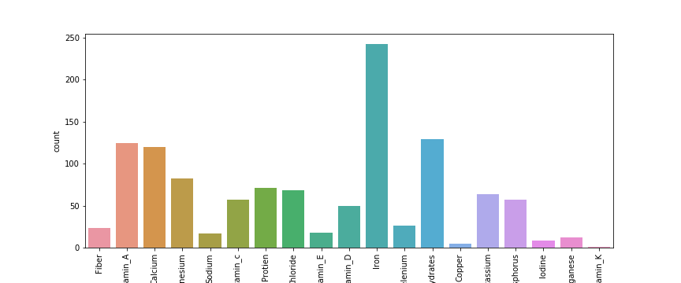
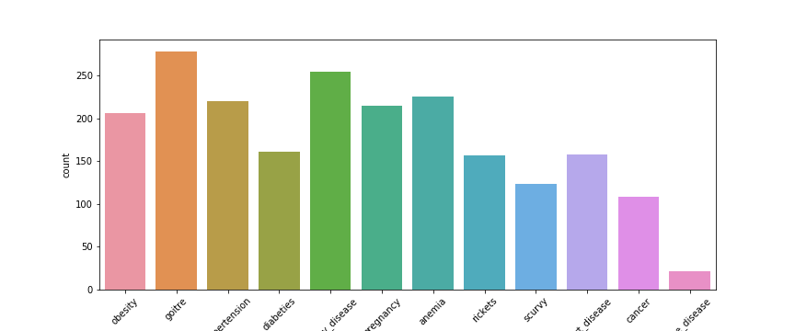
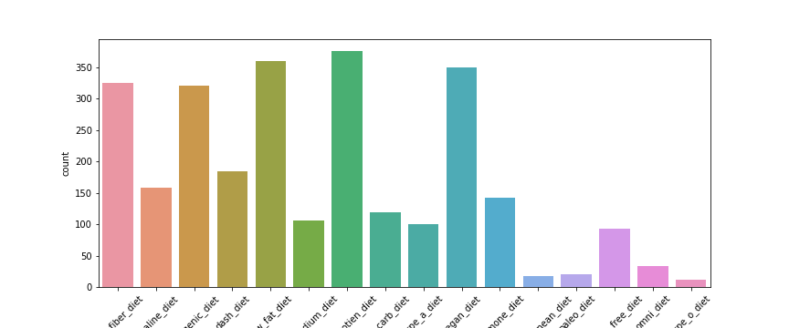
Final Dataset with columns:
Nutrient
Diet
Disease
Description (Ingredients)
Price (random for use)
Nutrient
Disease
Diet

Slide 18
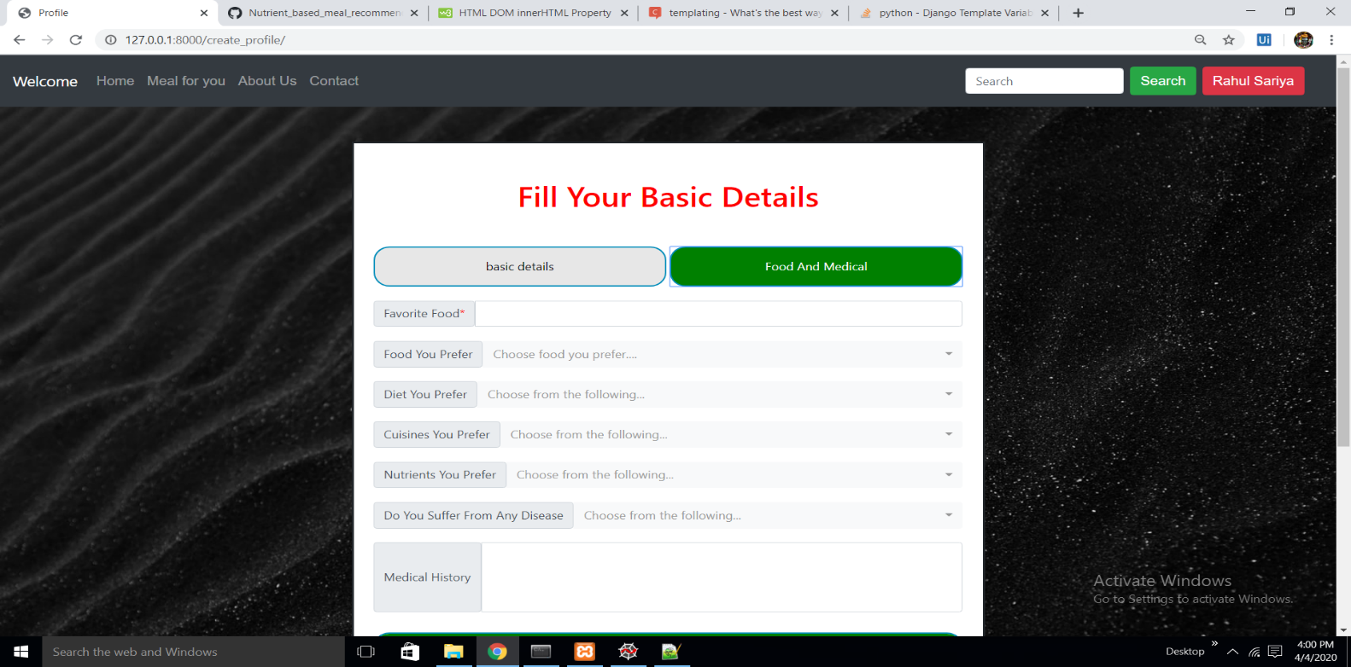
3. User’s Initial Recommendation based on his/her Profile
Taking basic preference from user like.. For his/her profile
Nutrient you prefer
Diet you prefer
Any disease if any
Food you prefer

Slide 19
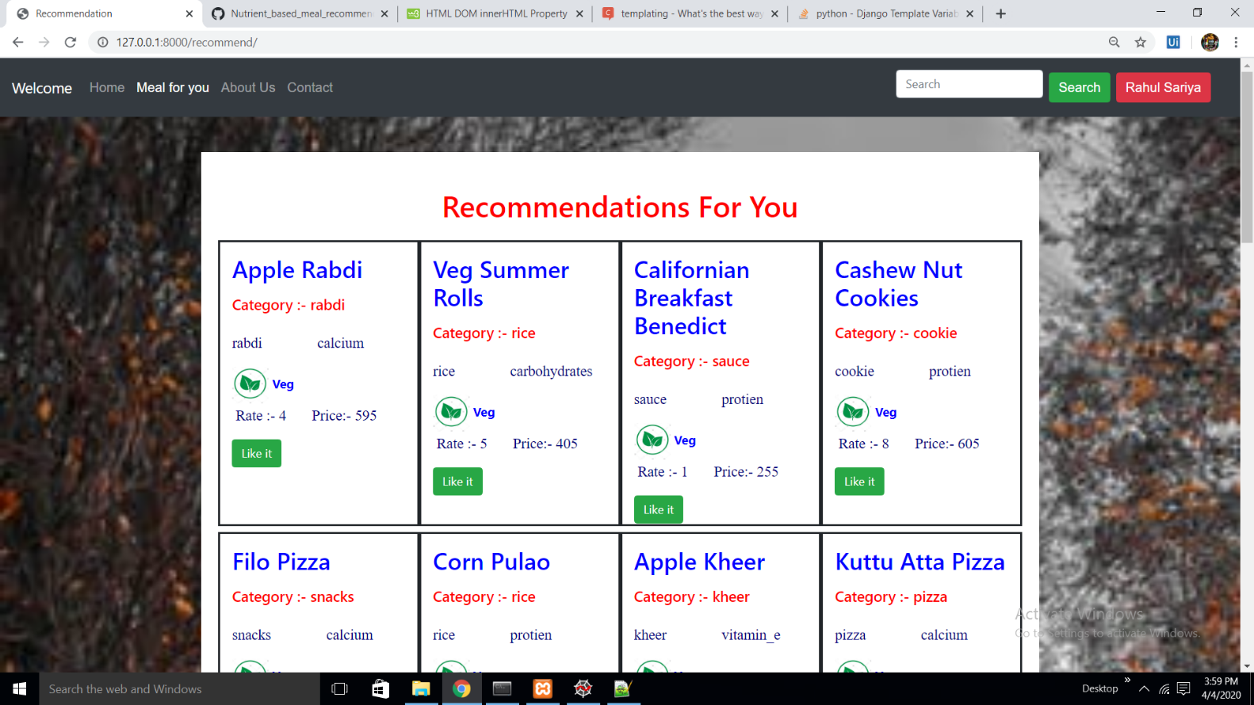
Initial Recommendation for user by his/her profile (Content-based filtering)

Slide 20
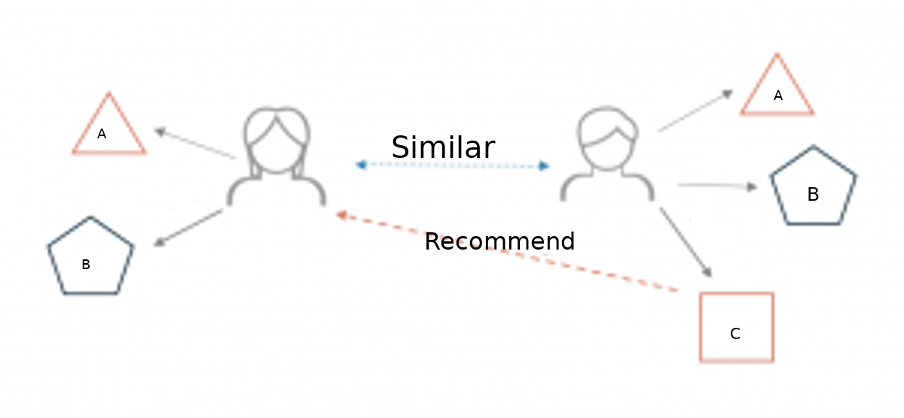
Implementing Collaborative filtering
User – User
In order to make a new recommendation to a user, user-user method roughly tries to identify users with the most similar “interactions profile” (nearest neighbours) in order to suggest items that are the most popular among these neighbours (and that are “new” to our user). This method is said to be “user-centred” as it represent users based on their interactions with items and evaluate distances between users.

Slide 21
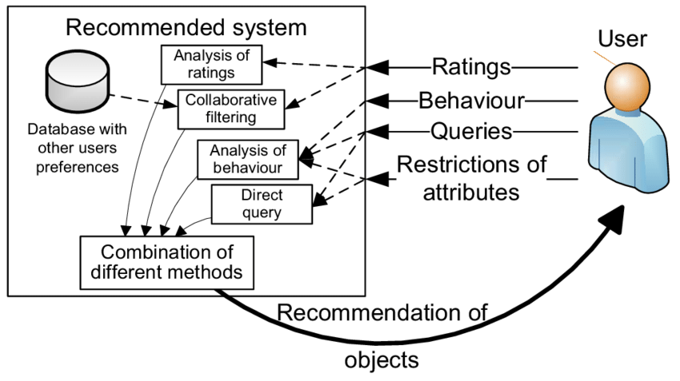
2.Item- Item
Recommending on the basis of users most liked , Rated Viewed or searched
First, we consider the item this user liked the most and represent it (as all the other items) by its vector of interaction with every users (“its column” in the interaction matrix). Then, we can compute similarities between the “best item” and all the other items. Once the similarities have been computed, we can then keep the k-nearest-neighbours to the selected “best item” that are new to our user of interest and recommend these items

Slide 22
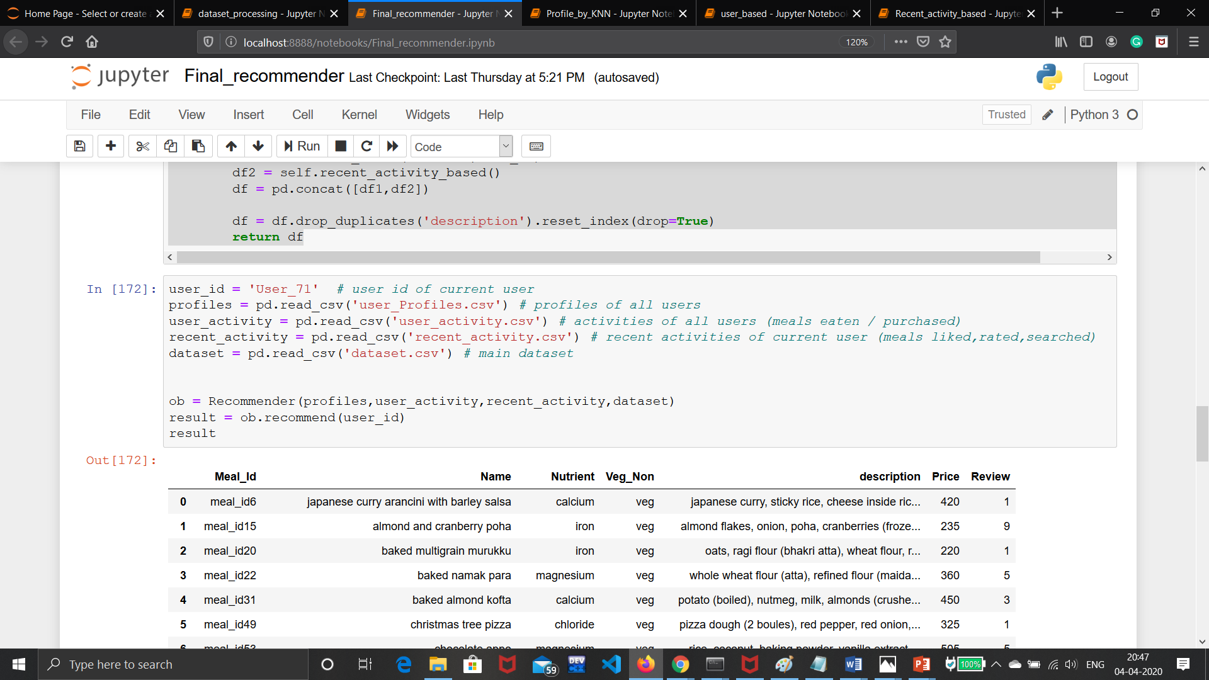
Combining Both Item-Item and user-user collaborative method for final Recommendation

Slide 24
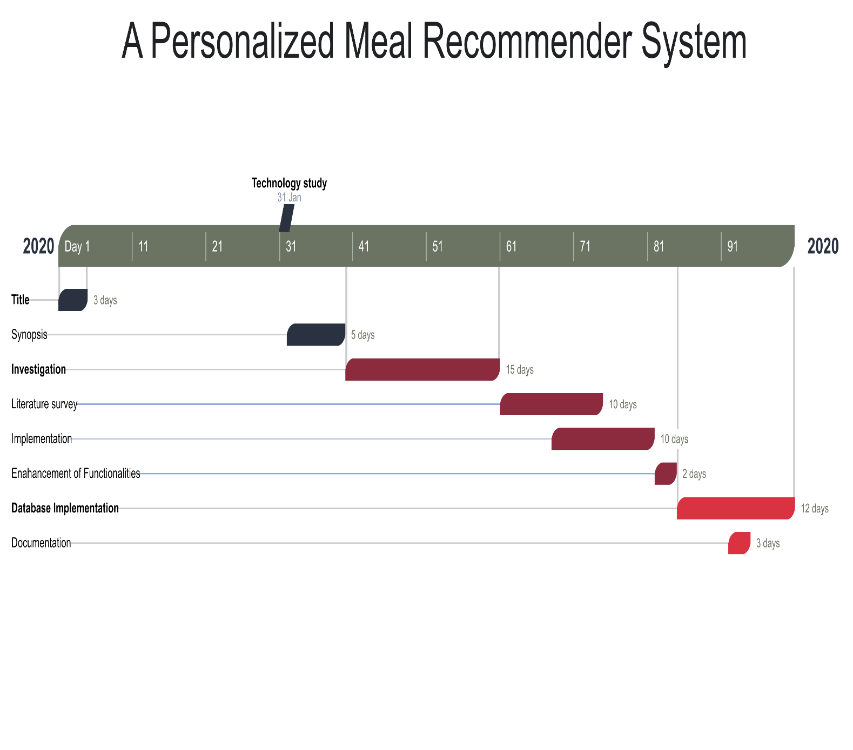
Gantt Chart

Slide 25
Conclusion
The project Meal Recommendation System successfully recommends meal on the basis of user’s preference
Thank you

